Slide 1
Probability & Statistical Modelling
AQ077-3-2-PSMOD and Version VD1
Hypothesis Testing

Slide 2
Topic & Structure of The Lesson
Introduction to hypothesis testing
Hypothesis testing on population mean
Hypothesis testing on population proportion
Test of Goodness-of-fit
Test of Independency

Slide 3
Learning Outcomes
At the end of this section, You should be able to:
Explain the principles underlying hypothesis testing
Structure a business decision situation about means or proportions into the form of a test of a hypothesis
Apply systematic testing procedures.
Interpret hypothesis test results and draw conclusions

Slide 4
Key Terms You Must Be Able To Use
If you have mastered this topic, you should be able to use the following terms correctly in your assignments and exams:
(Prepare your own list )
Hypothesis statement
Significance level
Test statistic
Decision rule
Critical value

Slide 5
Introduction
Alternatively called significance testing.
Is testing a belief or opinion by statistical methods.
In decision making, we make an assumption, called hypothesis, then we collect some sample data, produce sample statistics and use this information to decide how likely it is that our hypothesized population parameter is true.
Commonly used for testing sample means & proportion

Slide 6
In hypothesis testing, we must stated the assumed or hypothesized value of the population before we begin sampling.This assumption is called the null hypothesis.
The Null hypothesis (H_{o}) usually assumes there is no difference between the observed and believed values.
If our sample results fail to support the null hypothesis, then the conclusion that we do accept is called the alternative hypothesis, H₁.

Slide 7
There are only 4 possible results when we test a given hypothesis.
We accept a true hypothesis – a correct decision
We reject a false hypothesis – a correct decision.
We reject a true hypothesis – an incorrect decision. (Type I error)
We accept a false hypothesis – an incorrect decision. (Type II error)

Slide 8
Terminologies
Significance level
Complementary concepts to confidence limits.
Probability of committing a TYPE 1 error, naming rejecting the null hypothesis when in reality it is true.
There is no single standard or universal level of significance for testing hypothesis.
The higher the significance level, the higher the probability of rejecting a null hypothesis when it is true.

Slide 9
Type 1 error, α
Is the error of rejecting a null hypothesis when it is true.
Type 11error, β
Is the error of accepting a null hypothesis when it is actually false.
In order for any tests of hypothesis or rules of decision to be good, they must be designed so as to minimise errors of decision. The only way to reduce both types of errors is to increase the sample size.

Slide 10
One-tailed Test
Is a significance test in which the null hypothesis can be upset by values well above or below the mean but not both.
Two-tailed test
Is a significance test in which it will reject the null hypothesis if the sample mean is significantly higher or lower then hypothesized population mean.(i.e. there are two rejection region)

Slide 11
Procedures for Hypothesis Testing
State the null hypothesis, H0, and the alternative hypothesis H1.
Consider the appropriate distribution given by the null hypothesis.
Decide on the level of the test.
Decide on the rejection criteria.
Calculate the value of the test statistics.
for mean: Z = or t = for proportion: Z =
Make conclusion: If the value of test statistic lies in the critical region, reject H0
If the value of test statistic does not lie in the critical region, do not reject H0.
When σ not given and n < 30

Slide 12
Steps in Hypothesis Testing
Specify the population value of interest
Formulate the appropriate null and alternative hypotheses
Specify the desired level of significance
Determine the rejection region
Obtain sample evidence and compute the test statistic
Reach a decision and interpret the result

Slide 13
Required to know:
Hypothesis testing for one sample
Mean
One tailed test
Note that when sample size is 30 or less and the population standard deviation is not known, t-distribution is used.
Proportion
One tailed test

Slide 14
Example 1
The manufacturer of ‘Chummy Morsels’ claims that at least 8 out of 10 dogs choose his product rather than that produced by a rival firm. In a random sample of 200 dogs, 152 chose ‘Chummy Morsels’ and the rest chose the rival brand. Comment on the manufacturer’s claim. (Test at 5% level)
Conclusion: We do not reject H0 and conclude that there is not sufficient evidence, at the 5% level, to refute the manufacturer’s claim.

Slide 15
Example 2
A large college claims that it admits equal numbers of men and women. A random sample of 500 students at the college gave 267 males. Is there any evidence, at the 5% level, that the college population is not evenly divided into males and females?
Conclusion: We do not reject H0 and conclude that, at the 5% level, there is not sufficient evidence to refute the claim that the population is evenly divided into males and females.

Slide 16
Example 3
Experience has shown that the scores obtained in a particular test are normally distributed with mean score 70 and variance 36. When the test is taken by a random sample of 36 students, the mean score is 68.5. Is there sufficient evidence, at the 3% level, that these students have not performed as well as expected?
Conclusion: We do not reject H0 and conclude that there is not sufficient evidence, at the 3% level, that the students have not performed as well as expected.

Slide 17
Example 4
A machine produces elastic bands with breaking tension normally distributed with mean 45N and s.d. 4.36N. On a certain day a sample of 50 was tested and found to have a mean breaking tension of 43.46N. Test at the 5% level of significance whether this indicates a change in the mean.
Conclusion: We reject H0 and conclude that there is evidence, at the 5% level, of a change in the mean.

Slide 18
Example 5
A normal distribution is thought to have a mean of 50. A random sample of 100 gave a mean of 52.6 and a standard deviation of 14.5. Is there evidence that the population mean has increased at the 5% level?
Conclusion: We reject H0 and conclude that there is evidence, at the 5% level, that the population mean has increased.

Slide 19
Example 6
Five readings of the resistance, in ohms, of a piece of wire gave the following results:
1.51 1.49 1.54 1.52 1.54
and standard deviation = 0.019
If the wire were pure silver, its resistance would be 1.50 ohms. If the wire were impure, the resistance would be increased. Test, at the 5% level, the hypothesis that the wire is pure silver.
Conclusion: We reject H0 and conclude that at the 5% level, the wire is impure.

Slide 20
Non-parametric Tests
Introduction
The significance tests covered so far depend, to greater or less extent, on the assumption, or presence of the normal distribution
They are also concerned with the parameters of the distribution e.g. mean, proportion. Hence given the mean of parametric tests.

Slide 21
However, on occasions, the data are not normal, or contain extreme values or not enough is known to be able to make any assumption about the type of distribution. Then non-parametric or distribution free tests may be used.

Slide 22
Advantages of non-parametric tests
No assumptions need to be made about the underlying distribution
They can be used on data ranked in some order.
Mathematic concepts are simpler than for parametric tests

Slide 23
Disadvantages of non-parametric tests
They are less discriminating than parametric tests. I.e. they are more prone to error and less powerful
Although simple, the arithmetic may take a long time

Slide 24
Chi-square (χ²) Distribution
used when it is wished to compare an actual, observed distribution with a hypothesized, or expected distribution.
Often referred to as a ‘goodness of fit’ test
χ² =
where O = the observed frequency of any value E = the expected frequency of any value

Slide 25
The obtained value from the formula is compared with the value from χ² table for a given significance level and the number of degrees of freedom.
Degrees of freedom = (Rows-1)(Columns –1)
If χ² calculated is > χ² from table, the null hypothesis is rejected.

Slide 26
Use broadly for
Test of goodness of fit (for one way classification or for one variable only)
Can also be used to determine how well empirical distributions I.e. those obtained from sample data fit theoretical distributions such as the Normal, Poisson and Binomial
Test of independence (for more than one row or column in the form of a contingency table covering several attributes.)

Slide 27
Note that :
When calculating, the expected cell values, the expected frequency is less than 5, the χ² test becomes inaccurate. In such circumstances the cell which is less than 5 is merged with an adjoining cell so that the expected frequencies in all resulting cells are at least 5.

Slide 28
Chi-square Goodness-of-fit Test
Does sample data conform to a hypothesized distribution?
Examples:
Are technical support calls equal across all days of the week? (i.e., do calls follow a uniform distribution?)
Do measurements from a production process follow a normal distribution?

Slide 29
Example 7
Example:
Are technical support calls equal across all days of the week? (i.e., do calls follow a uniform distribution?)
Sample data for 10 days per day of week:
Sum of calls for this day:
Monday 290
Tuesday 250
Wednesday 238
Thursday 257
Friday 265
Saturday 230
Sunday 192
Σ = 1722

Slide 30
Logic of Goodness-of-Fit Test
If calls are uniformly distributed, the 1722 calls would be expected to be equally divided across the 7 days:
Chi-Square Goodness-of-Fit Test: test to see if the sample results are consistent with the expected results

Slide 31
Observed & Expected Frequencies
 | Observed o_{i} | Expected e_{i}
Monday Tuesday Wednesday Thursday Friday Saturday Sunday | 290 250 238 257 265 230 192 | 246 246 246 246 246 246 246
TOTAL | 1722 | 1722

Slide 32
Chi-Square Test Statistic
H₀: The distribution of calls is uniform over days of the week
H_{A}: The distribution of calls is not uniform
The test statistic is
where:
k = number of categories
o_{i} = observed cell frequency for category i
e_{i} = expected cell frequency for category i

Slide 33
The Rejection Region
H₀: The distribution of calls is uniform over days of the week
H_{A}: The distribution of calls is not uniform
Reject H₀ if
α
(with k – 1 degrees of freedom)
0
χ²
Do not
reject H₀
χ²_{α}
Reject H₀

Slide 34
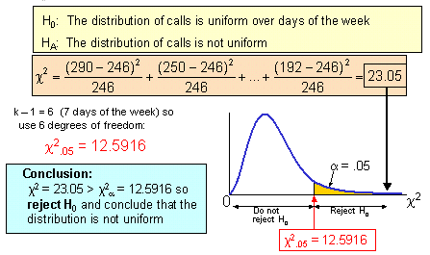
Chi-Square Test Statistic

Slide 35
Contingency Tables
Situations involving multiple population proportions
Used to classify sample observations according to two or more characteristics
Also called a cross-tabulation table.

Slide 36

Example 8:
The following data concerning industrial accidents and absentees classified according to the types of employee.
Is there any evidence to suggest that the severity of accident is associated with type of employee ?

Slide 37
Logic of the test
H₀: Severity of accident is independent of type of employees
H_{A}: Severity of accident is not independent of type of employees
If H₀ is true, then the proportion of severity of accidents should be the same as the proportion of type of employees

Slide 38
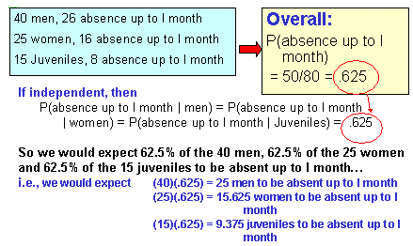
Finding Expected Frequencies

Slide 39
Finding Expected Frequencies
Expected frequency

Slide 40
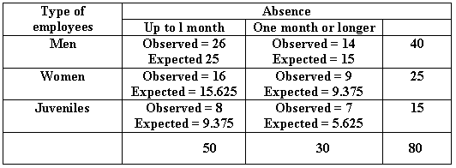
Observed vs. expected Frequencies

Slide 41
The Chi-square contingency test statistic is:
where:
O = observed frequency
E = expected frequency
r = number of rows
c = number of columns

Slide 42
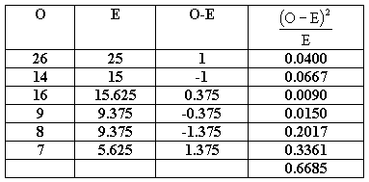

Slide 43
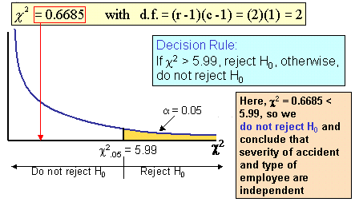
Contingency Analysis

Slide 44
Yate’s Correction
Used when there is only ONE degree of freedom.

Slide 45
Example:
Left-Handed vs. Gender
Dominant Hand: Left vs. Right
Gender: Male vs. Female
H₀: Hand preference is independent of gender
H_{A}: Hand preference is not independent of gender

Slide 46
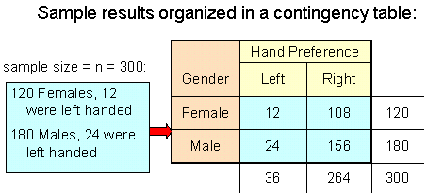
Quick Review Question
Example:

Slide 47
Logic of the test
H₀: Hand preference is independent of gender
H_{A}: Hand preference is not independent of gender
If H₀ is true, then the proportion of left-handed females should be the same as the proportion of left-handed males
The two proportions above should be the same as the proportion of left-handed people overall

Slide 48
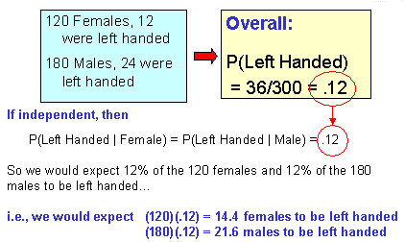
Finding Expected Frequencies

Slide 49
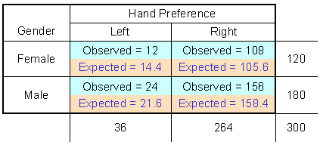
Observed vs. expected Frequencies

Slide 50
The Chi-square contingency test statistic is:
where:
O = observed frequency
E = expected frequency
r = number of rows
c = number of columns

Slide 51
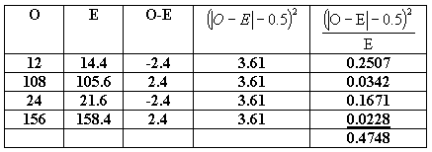

Slide 52
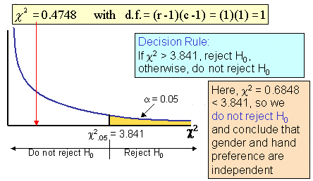
Contingency Analysis

Slide 53
Summary of Main Teaching Points
Hypothesis testing on population mean and proportion

Slide 54
Question and Answer Session
Q & A

Slide 55
What we will cover next
Decision Making Techniques

